Slide 1



Presented by Rajesh Goldy
YOUTUBE
ANALYSIS
Analyzing Youtube’s Trending Videos

Slide 2




THE TEAM
Shagufta Henna
Rajesh Goldy
PhD, Professor at ATU
Master’s student at ATU

Slide 3

TABLE OF CONTENTS
1
Introduction
2
Project Pipeline
3
EDA
4
Feature Engineering
5
Model Training
6
Conclusion

Slide 4


INTRODUCTION
A dataset of the daily top trending YouTube videos is gathered to predict the number of views based on parameters like video likes, dislikes, country, and many more.
Several algorithms are trained to find the patterns responsible for a video to be trending or popular.

Slide 5
DATA DESCRIPTION
CSV Data
JSON Data
Number of files: 4 {CA, IN, US, FR}videos.csv
Shape: 159906 rows × 16 columns
Columns: Trending data, title, channel_title, category id, publish time, tags, likes, dislikes, comment count, thumbnail link, comment disabled, rating disabled, video error or removed, description, country
5339 rows are dropped because of null values in the dataset
Average likes are 40961.05 with a standard deviation of 152149.0, resulting in a skewed distribution
The mean of disliked videos is 2056.138 with a standard deviation of 18258.54
Childish Gambino - This Is America, recorded the highest number of views at 2.252119e+08; however, BTS gets the highest number of comments on it at 1.228655e+06
Youtube itself gets the highest number of dislikes at 1.643059e+06
Number of files: 4 {CA, IN, US, FR}_category_id.json
Shape: 125 rows × 3columns
Columns: kind, etag, items-> a dict {'kind': 'youtube#videoCategory', 'etag': '"XI7....TA"', 'id': '2', 'snippet': {'channelId': 'UCB...tcQ', 'title': 'Autos & Vehicles', 'assignable': True}}e

Slide 6
Project Pipeline
EDA
3
JSON
Combine data
2
4
5
6
1
Feature Engineering
Data Preprocessing
Feature Selection
Random Forest
CSV
Train Model
AdaBoost
XGBoost

Slide 7

EDA

Slide 8

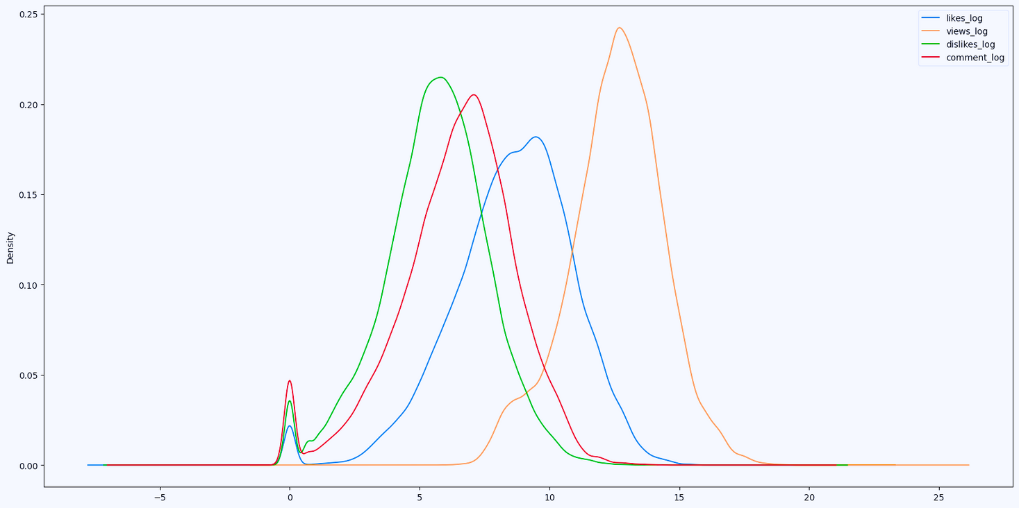
User’s Activity
Users who are watching YouTube are more likely to like the video followed by commenting on it.

Slide 9

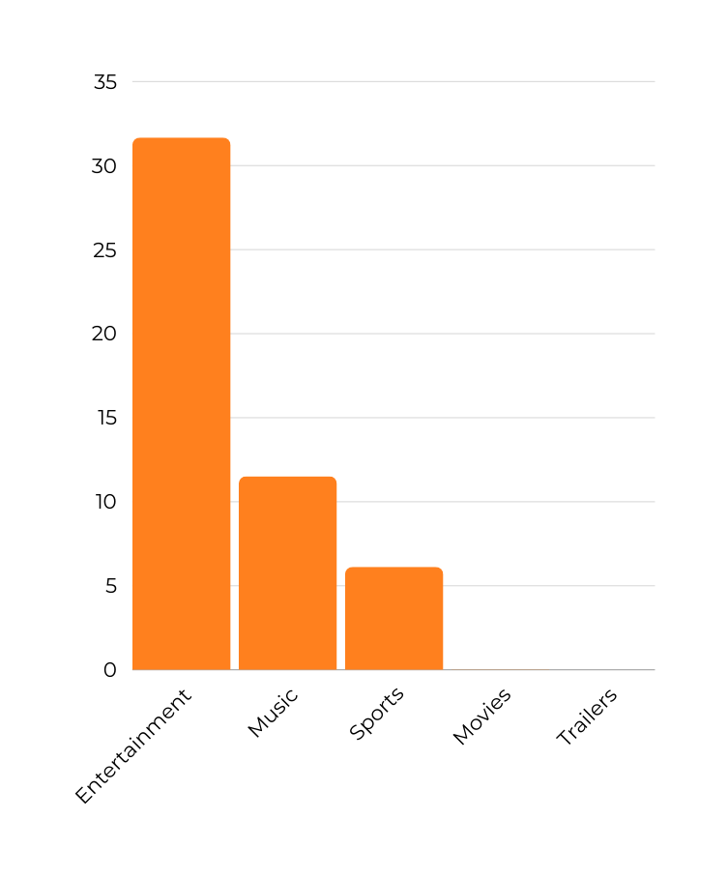

Popularity
Entertainment holds the top position for the highest number of uploaded videos on YouTube, followed by Music.
31.6%
0.02%
Entertainment
Trailer
Notes:
This graph visualizes the distribution of uploaded videos by sector, with entertainment having the highest number of uploads, followed by music.

Slide 10
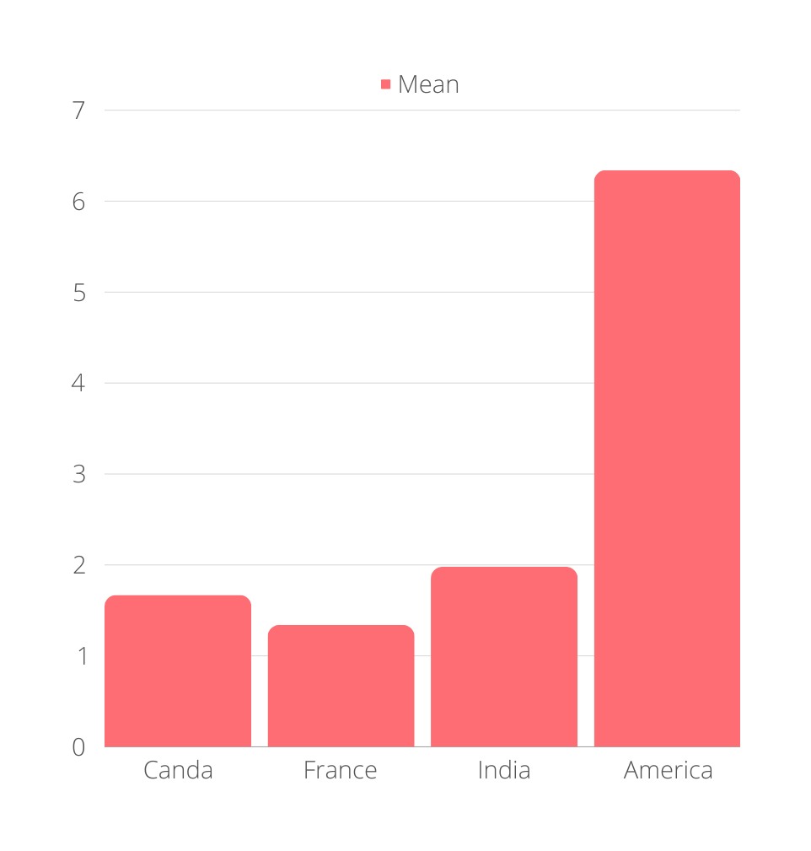
VIDEO TREND IN A COUNTRY
01 - AMERICA
02 - INDIA
03 - CANADA
Notes:
This chart depicts the average trend of video viewership by country, with the United States leading the rankings. In other words, when a video is trending, it tends to be watched at a higher rate in the United States, followed by India.

Slide 11
Liked channels
Disliked channels
ibighit
Marvel Entertainment
Dude Perfect
ChildishGambinoVEVO
PewDiePie
YouTube Spotlight
Logan Paul Vlogs
ChildishGambinoVEVO
Call of Duty
Jake Paul
T
O
P
5
Contributing channel
Popular because of dislike
VikatanTV
The Late Show with Stephen Colbert
RadaanMedia
WWE
TheEllenShow
Jeffrey Tambor Fired From 'Transparent'
5 Things You Missed at the 2018
Fergie Performs The U.S. National Anthem
Staudt on Sports I 1-22-18
WATCH: Sen. Mitch McConnell on tax reform

Slide 12
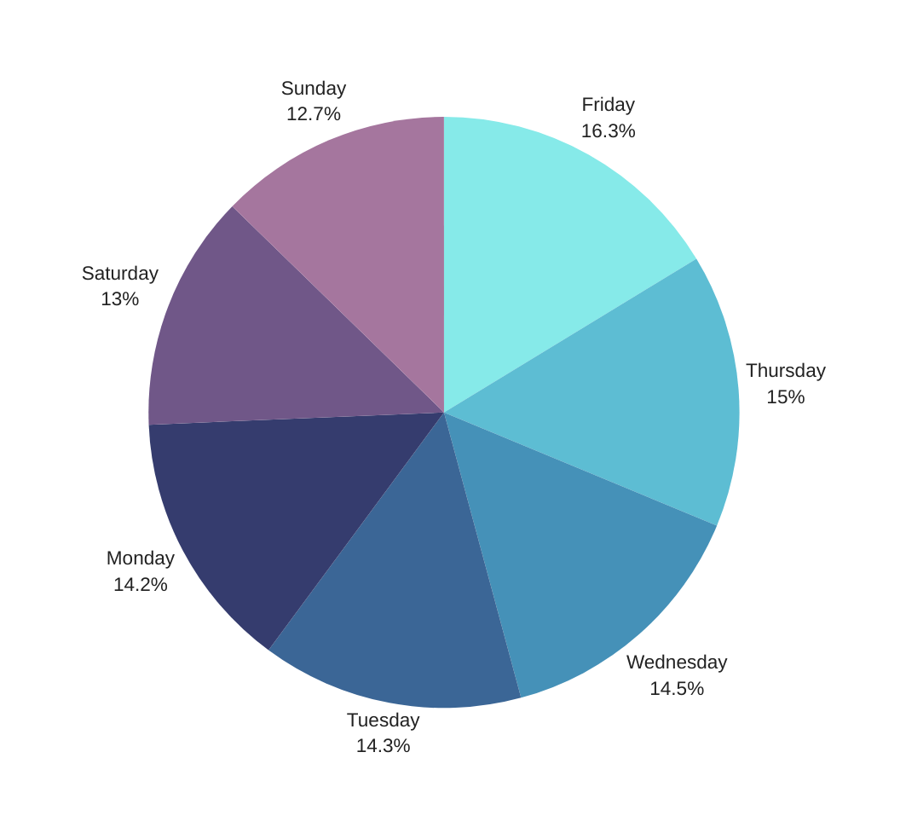
Day of Week
YouTubers are more inclined to upload videos on Friday at 16.3%
Sunday experiences the least popularity for uploading YouTube videos.
The publishing rates on Monday, Tuesday, and Wednesday are approximately similar.

Slide 13

FEATURE
ENGINEERING

Slide 14
DESIGNING
Number of tags
Description & title
Publish Day
It encloses the number of tags associated with each video, providing valuable information to the model to find the patterns and relationships between number of tags and views
Combined length of description and title to undercover the correlations between video views and the textual length, to predict the number of views based on the length of characters provided by the YouTube regarding their video
Derived from the publish time, to examine the potential relationship between views and the day of the week a video is published.
Notes:
Number of tags: This column is extracted from the column named tags, which is a representation of the number of tags present in the tags column
Description and Title: This column calculates the length of the description and title, the idea here is to find the relationship between the number of views and the length of the description provided by YouTubers.
Publish Day: the day of publishing is extracted from the publish time, to find the relationship between views and publish days
Publish Day: Derived from the publish time, the publish day is examined to explore potential relationships between views and the specific day of the week a video is published.

Slide 15
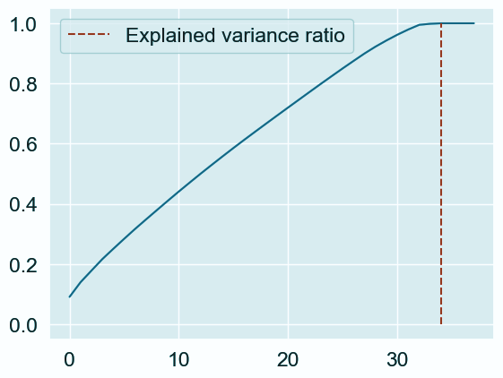
Principle Component Analysis
Reduce the dimension of the dataset by preserving the relevant column
Aids in removing curse of dimensionality

Slide 16
MODEL
TRAINING

Slide 17






AdaBoost
Weak Learner
Prediction
Data
Notes:
AdaBoost stands for (Adaptive Boosting)
Scikit-Learn uses a multiclass version of AdaBoost called SAMME (which
stands for Stagewise Additive Modeling using a Multiclass Exponential loss function

Slide 18





XGBoosting
Training Parallel
Mostly used in Kaggle competitions
Can be regularized

Slide 19
MODEL -
Results
ALGORITHM | TRAIN R2 | TEST R2 | TRAIN MSE | TEST MSE
StackingRegressor | 0.99 | 0.93 | 0.14 | 0.47
Random Forest | 0.98 | 0.92 | 0.18 | 0.48
XGBoost | 0.95 | 0.92 | 0.37 | 0.49
AdaBoost (With Grid Search) | 0.99 | 0.93 | 0.019 | 0.47
XGBoost (With Grid search cv) | 0.95 | 0.92 | 0.38 | 0.51

Slide 20
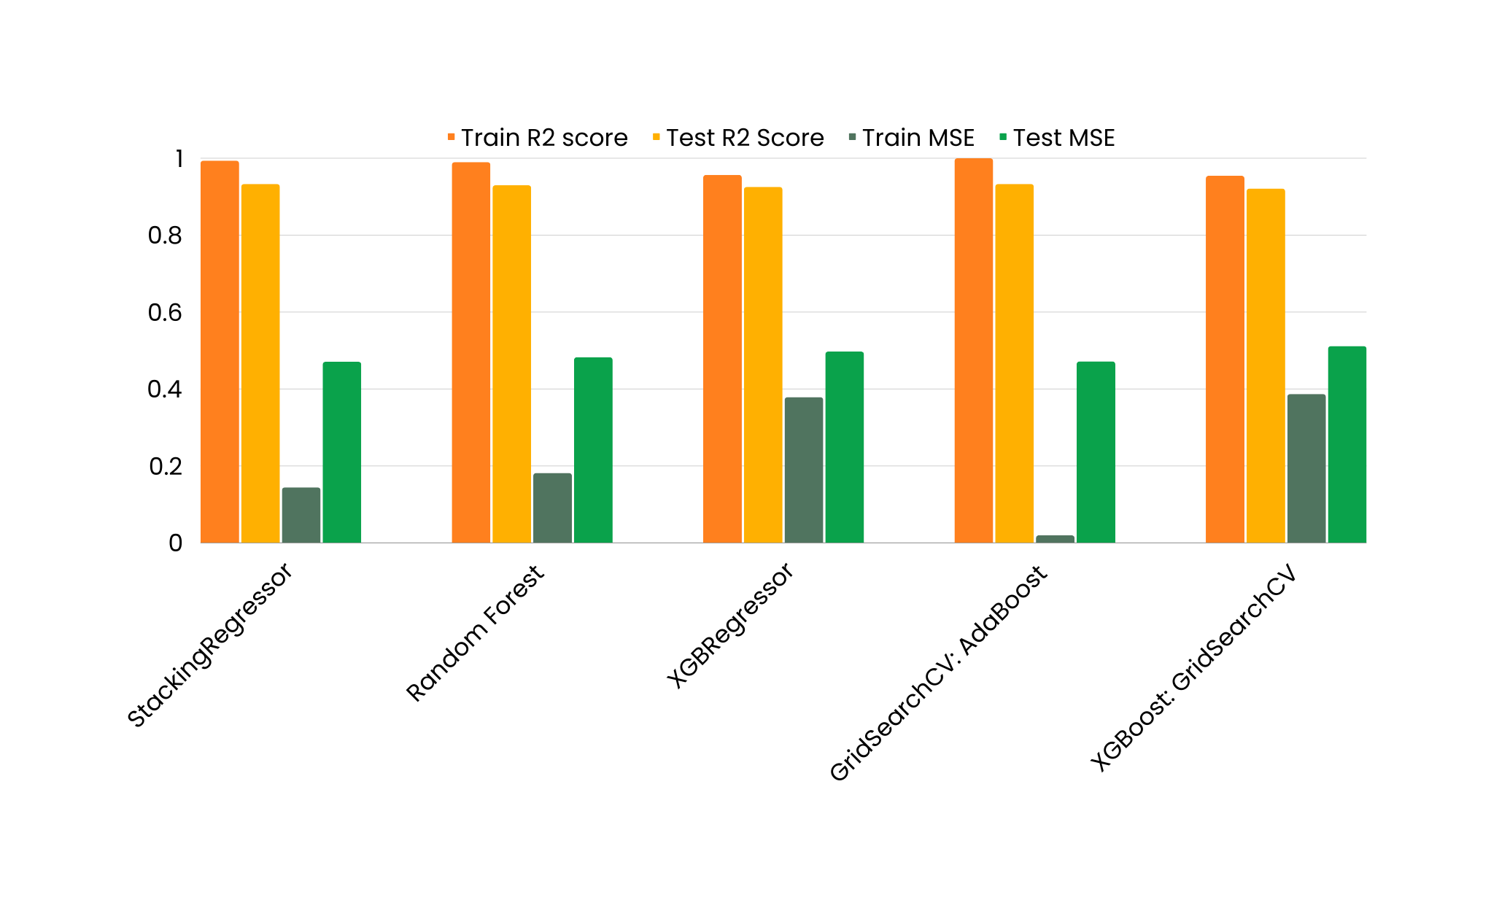
Results

Slide 21
Conclusion
Initially Random Forest is used to train the model with all the parameters after implementation of PCA and achieved the test score of 0.93
Random Forest helped to select the top 10 features
XGBoost outperformed the best in terms of lower overfitting to the dataset
There is a higher correlation between likes and dislikes
Top features which contributed to predict the number of views are dislikes, likes, comment, length of title and description

Slide 22
Conclusion
Initially Random Forest is used to train the model with all the parameters after implementation of PCA and achieved the test score of 0.93
Random Forest helped to select the top 10 features
XGBoost outperformed the best in terms of lower overfitting to the dataset
There is a higher correlation between likes and dislikes
Top features which contributed to predict the number of views are dislikes, likes, comment, length of title and description
Recommendations
Categorising YouTube videos based on their comments
Training ML algorithms to generate their own YouTube comments.
Analysis to understand the patterns over time

Slide 23

www.github.com/goldirana/youtube
THANK
YOU!

Slide 24
Appendix

Slide 25
Reference
Hands-On Machine Learning with Scikit-Learn, Keras, and TensorFlow, 2nd Edition by Aurélien Géron
DataSet: https://www.kaggle.com/datasets/datasnaek/youtube
XGBoost: https://medium.com/almabetter/xgboost-a-boosting-ensemble-b273a71de7a8

Slide 26
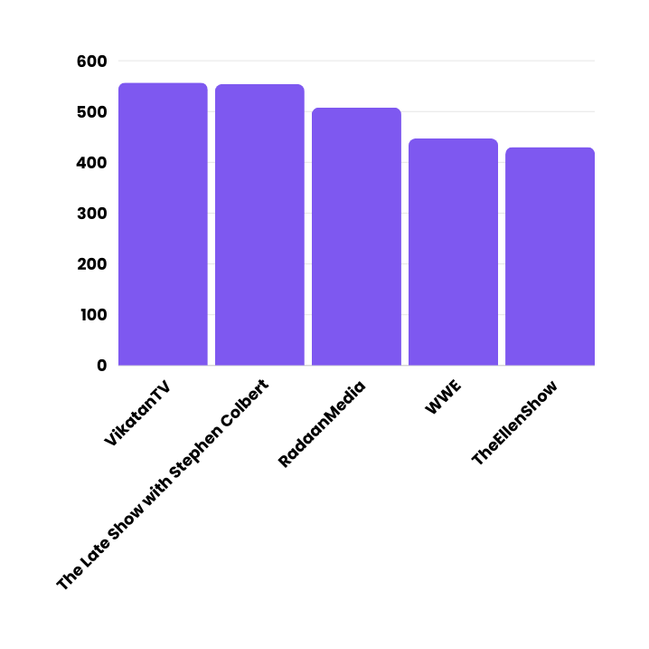





Top Contributing channels
The top contributing channel on YouTube is VikatanTV followed by Late night show

